Slide 1

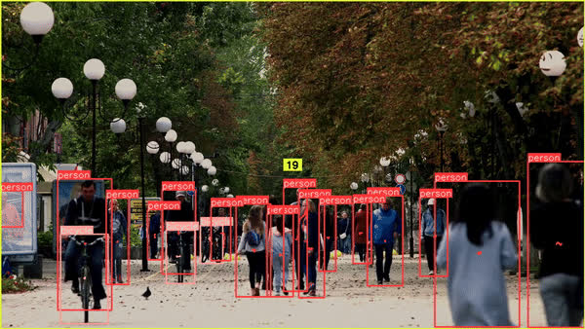
Objects Tracking and Counting
Hands On

Slide 2

Introduction to Object Tracking and Counting
1
Object Tracking
    Definition: Identifying and following the movement of objects across video frames.
    Importance: Essential for monitoring in scenarios like crowd surveillance and traffic management.
Object Counting
    Definition: Quantifying the number of objects or individuals in a scene.
    Applications: Useful in retail for tracking foot traffic, in event management for crowd control, and in urban planning for traffic analysis.
2

Slide 3
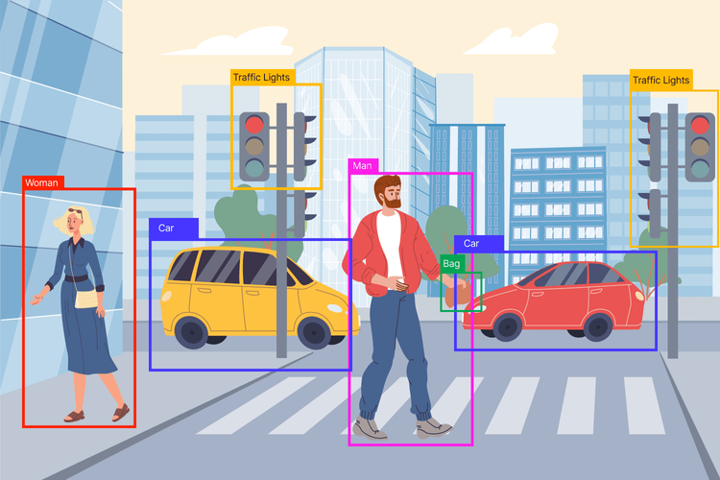
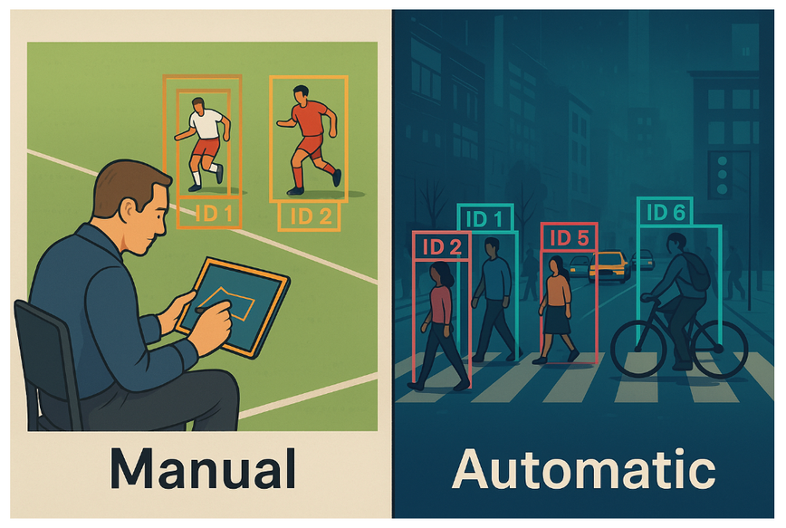
Object Counting Framework
Detection
Tracking
Counting
+
=

Slide 4
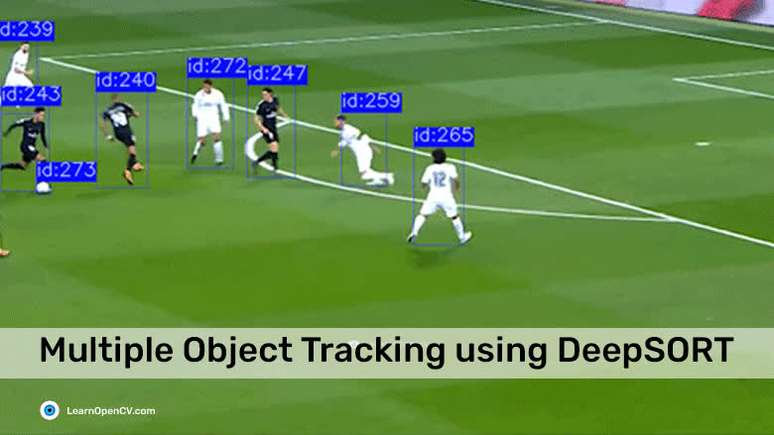
Multiple Object Tracker
Multiple Object Tracker (MOT)
  Purpose: Ideal for scenarios where multiple objects need to be detected and tracked.
  Operation: Begins with object detection, followed by tracking each detected object in single or consecutive frames.
  Algorithms:
    DeepSORT
    FaitMOT
    ByteTrack
    BotSORT
  Application: Useful in high-density environments like urban traffic or crowded events where numerous objects interact dynamically.
Source: LearnOpenCV.com

Slide 5
Object Counting Methods
Whole-Frame: Counts all objects in the frame.

Slide 6
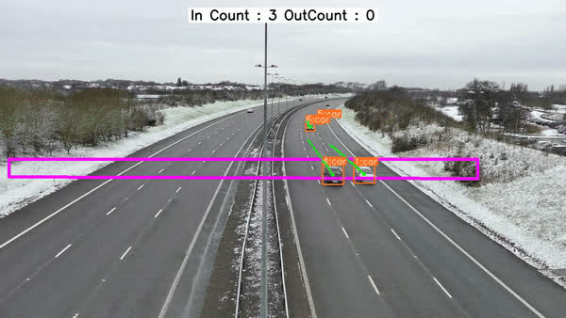
Object Counting Methods
In/Out Counting: Distinguishes entries and exits in designated zones.

Slide 7
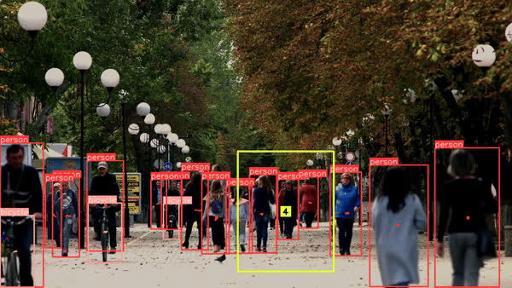
Object Counting Methods
Zone-Based: Counting within a specific area.

Slide 8
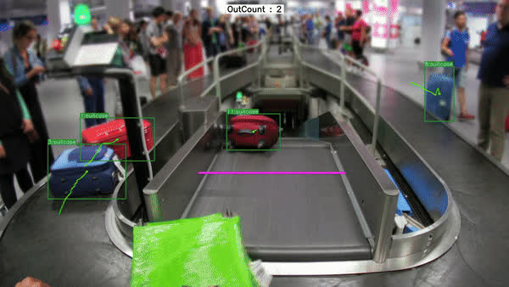
Object Counting Methods
Line Counting: Tallying objects as they cross a predefined line.

